Slide 1
Validating R for Pharma
Streamlining the Validation of Open-Source R Packages within Highly Regulated Pharmaceutical Work
Presented by Anuja Das on behalf of the R Validation Hub

Slide 2
Agenda
The R Validation Hub
Our White Paper
{riskmetric}
{riskassessment}
Regulatory R Package Repository
Communications
1
2
3
4
5
6

Slide 3

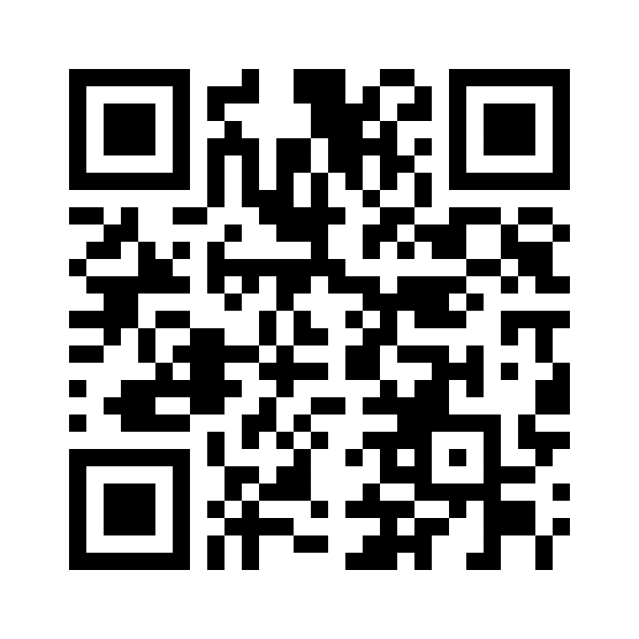
BUT FIRST

Slide 4

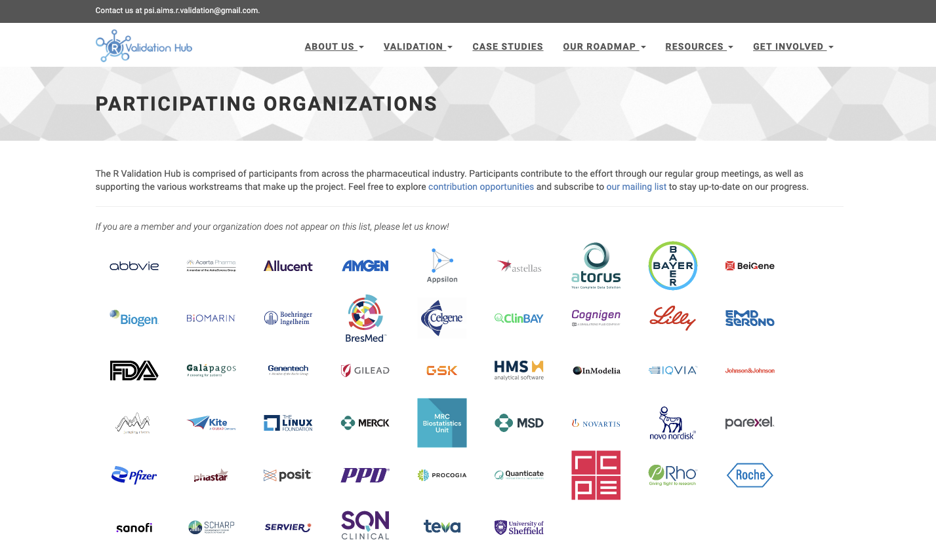
What is the R Validation Hub?
Nested under the R Consortium
Cross industry collaboration of over fifty biotech and pharmaceutical companies
Initial aim: Consolidate definitions, regulations, and best practices for qualification and validation of the open-source language
Current State: Grown to include a variety of workstreams that produce resources and tools for open-source use aligning with the expectations of regulatory agencies

Slide 5
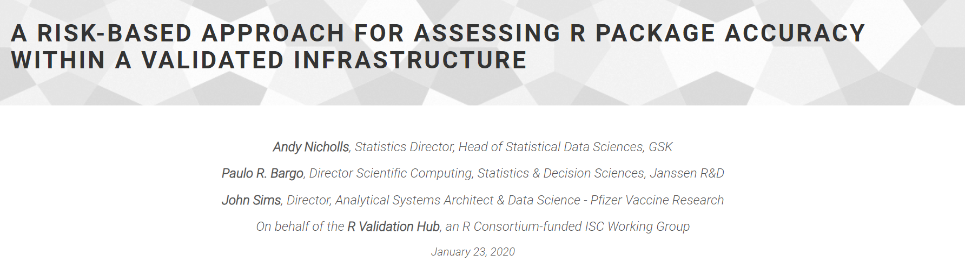
The White Paper

Slide 6



The White Paper
A Risk-Based Approach for Assessing R Package Accuracy within a Validated Infrastructure
Focuses on systems validation and adequate testing and documentation in keeping with the FDA’s “Statistical Software Clarifying Statement”
Accuracy
Reproducibility
Traceability
“For Intended Use”

Slide 7
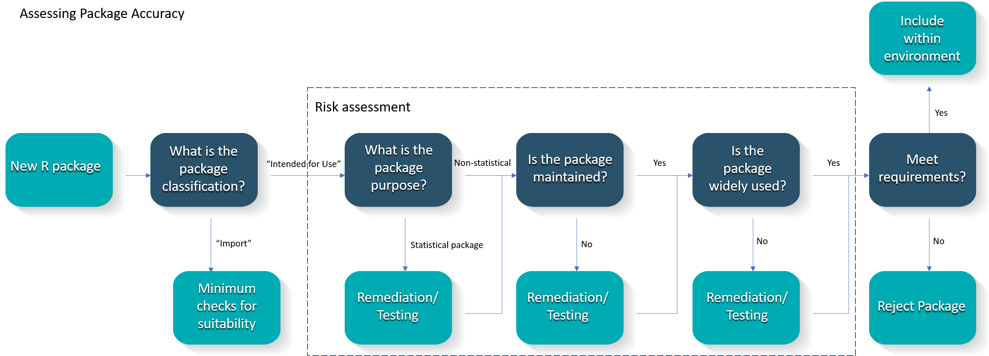
The White Paper
Proposed Risk-Based Approach to Assess Accuracy

Slide 8
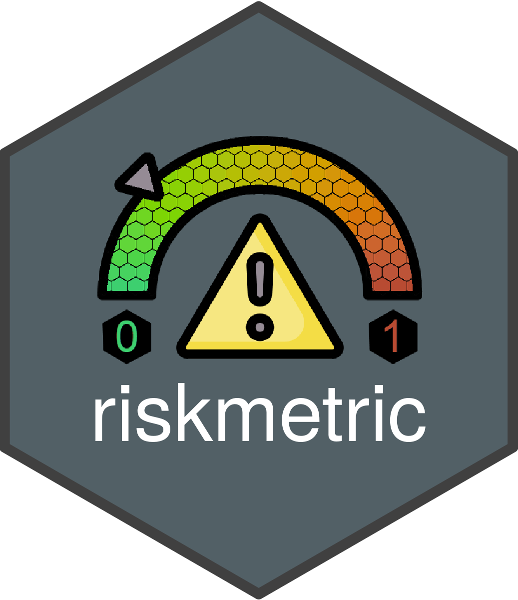
Tool 1: Quantify Risk Programmatically

Slide 9
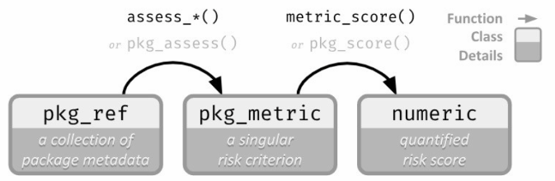
{riskmetric}
How it Works
Perceived Risk
Quantified Risk

Slide 10
{riskmetric}
How Quality can be Quantified
A license
Source code available for browsing
An easy to contact maintainer
Up-to-date news regarding new features and bugs
A place to report bugs
Evidence that new bugs are being addressed
Package documentation & user guides/ perhaps a website
Complete Function documentation
Adequate test coverage
Community usage
Many more!
Developer SDLC
Community Exposure

Slide 11
{riskmetric}
Who can use this?
Currently | Future
Package Developers | Novice R users
System Administrators | Non-Technical Users
Programmers

Slide 12
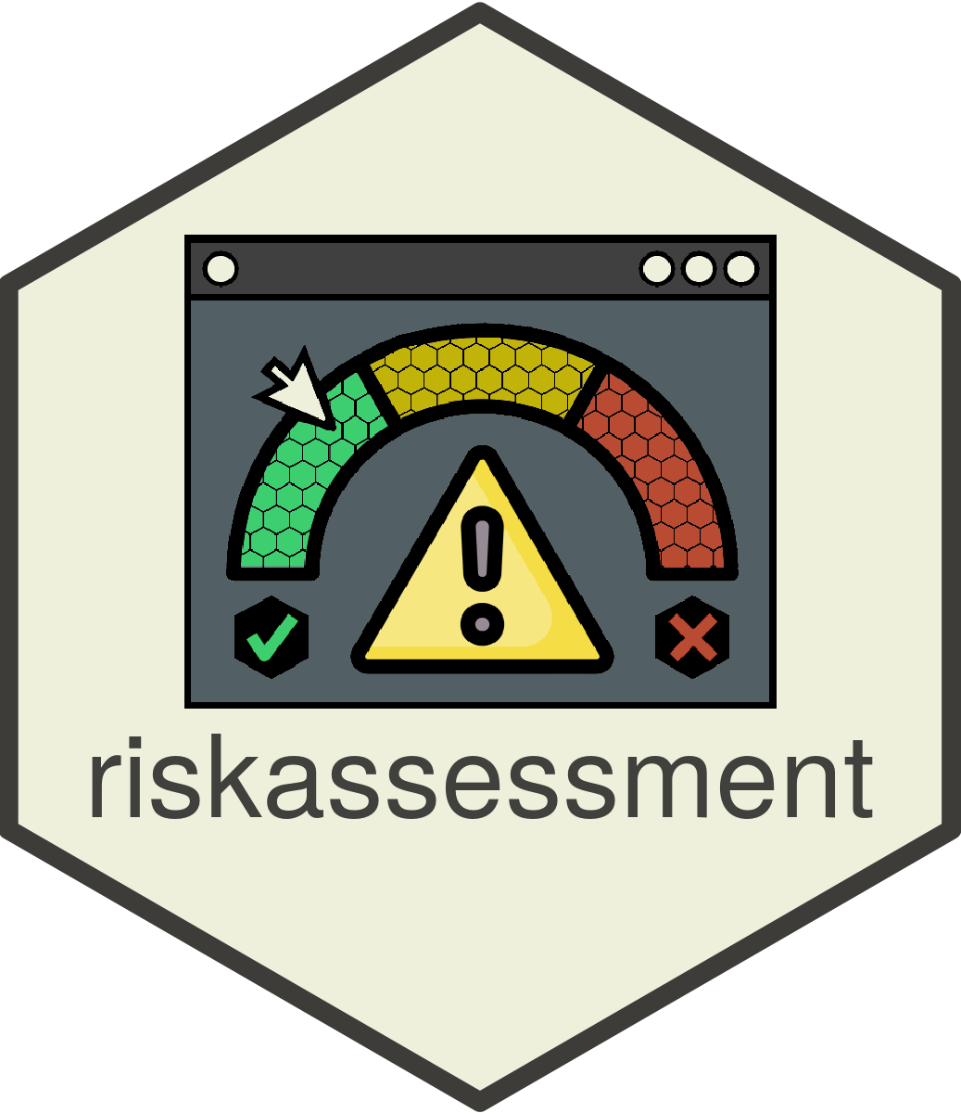

Tool 2: Interactive App using {riskmetric}
Voted ‘Best App’ at Shiny Conference 2023

Slide 13
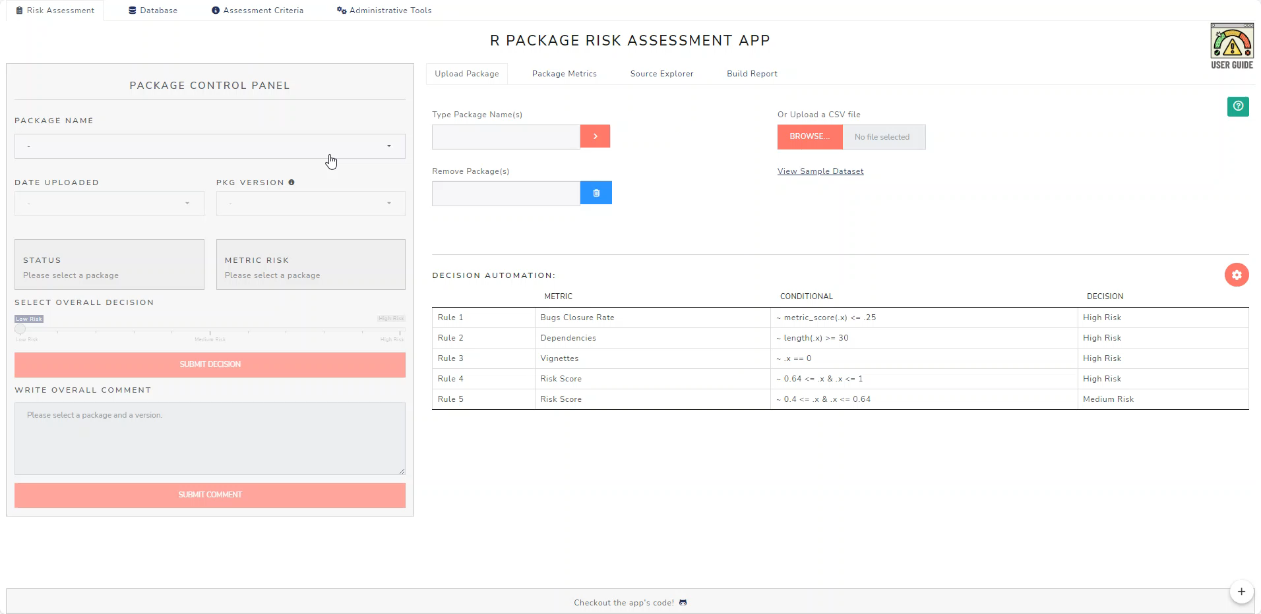
{riskassessment}
How it Works

Slide 14
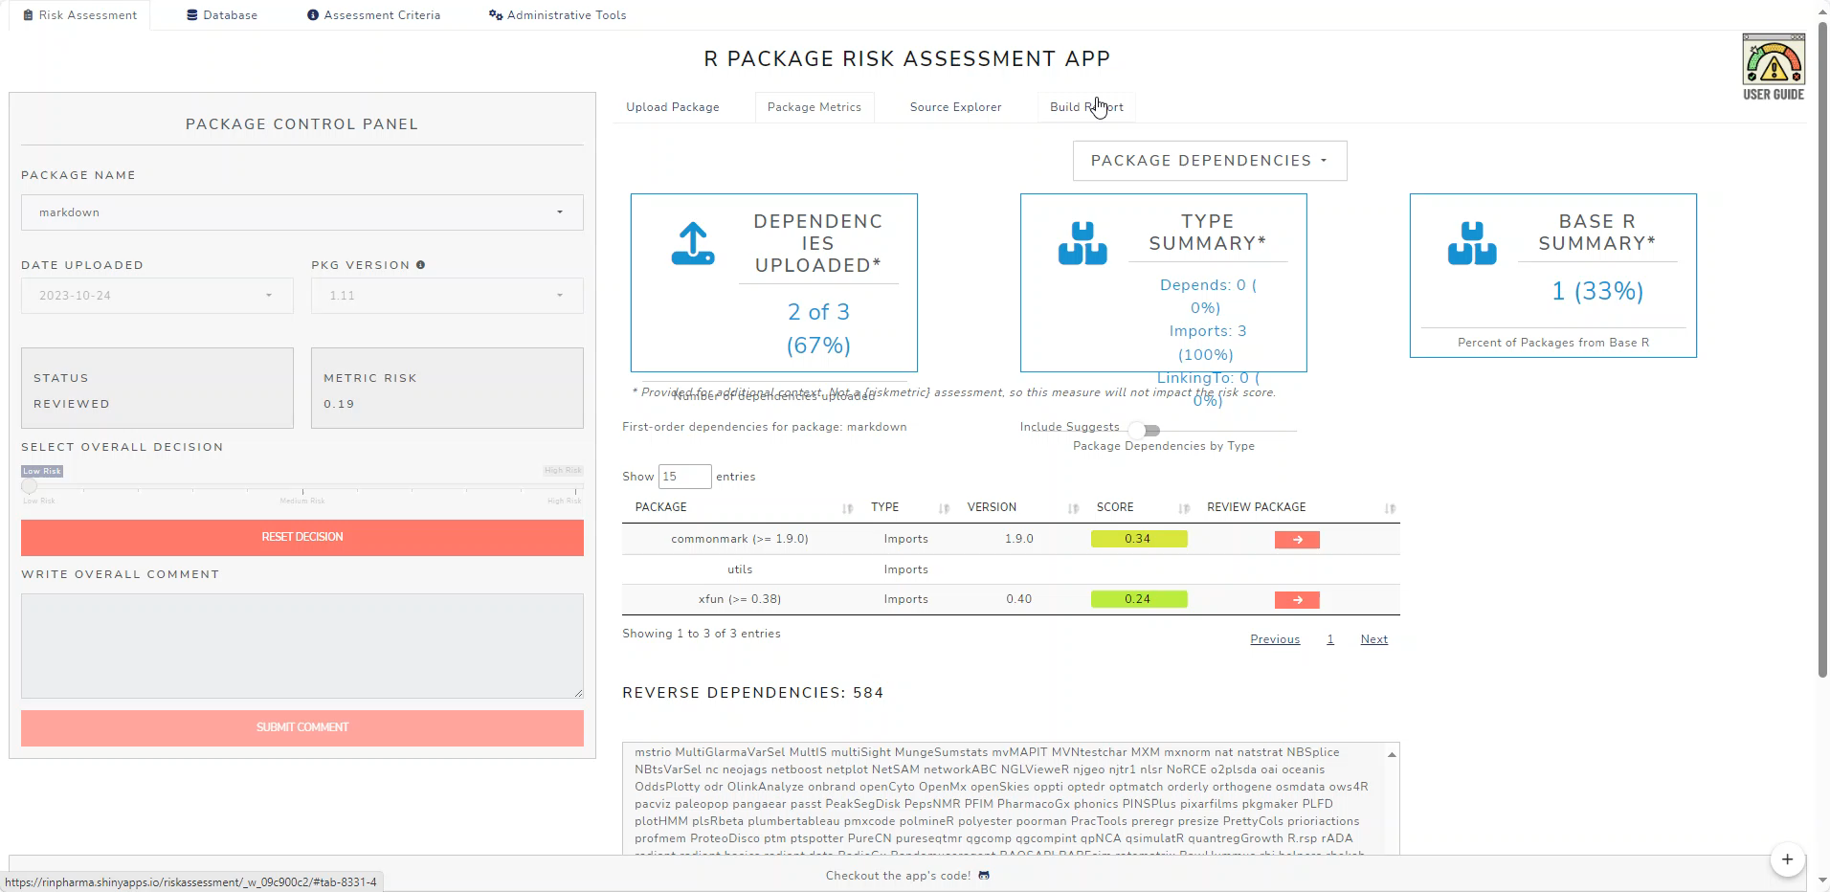
{riskassessment}
Tailored for Organizational Use

Slide 15
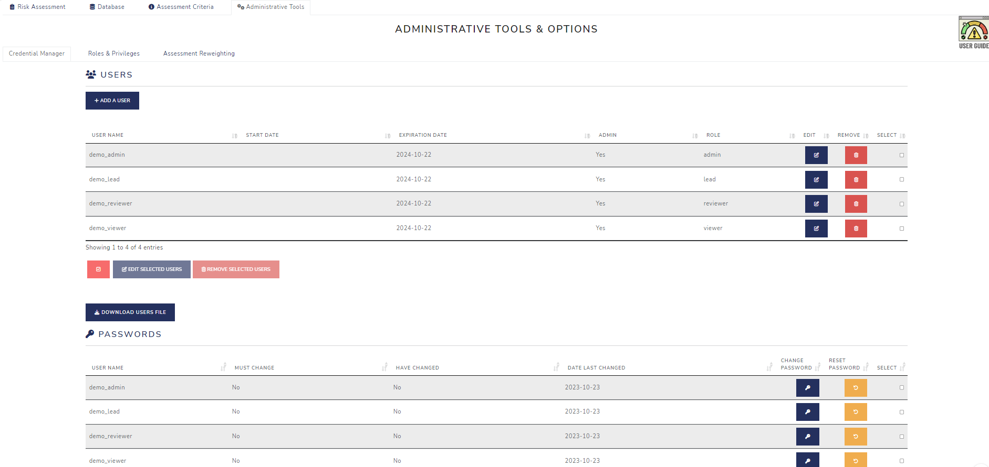
{riskassessment}
Tailored for Organizational Use

Slide 16

Repositories Workstream

Slide 17
Regulatory Repositories
Business Driver and Scope
Why?
Scope for the Pilot
Simplify the burden of assembling and storing documentation and evidence of R Package testing and validation assessments
Cross-industry repository would reflect the true essence of open-source collaboration
Ultimate risk reduction of using R packages for regulatory submissions
Base Reference Image
Basic Automated Validated Pipeline
Basic Repository to store and manage validated R packages
Slated for Q3 2024

Slide 18

Communications

Slide 19
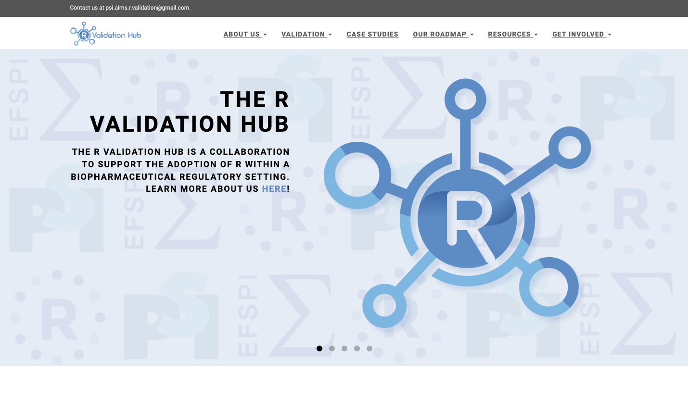
Communications
Our Platforms
Website
Community Meetings
Internal R Groups
pharmar.org
Past topics have included:
Unraveling the term ‘Validation’
A Deep Dive into our tools and resources
Reflecting on industry case studies
Build connections with different companies to identify common goals, projects, and gaps
Helps the R Validation Hub build out our roadmap and work on the most topical workstreams
New Website Coming This Summer!

Slide 20




Communications
Get Involved!!!
The R Validation Hub is always looking to expand their network. These are a few ways to join in.
Be a part of our Working Groups
Join our mailing list and attend Community Meetings
Tell us your ideas
Submit a Case Study

Slide 21
Questions
Key Contacts:
Presentation and Communication: Anuja Das Anuja.das@biogen.com
{riskmetric}: Eric Milliman eric.milliman@biogen.com
{riskassessment} Aaron Clark aclark02@arcusbio.com
R Regulatory Repositories Coline Zeballos coline.zeballos@roche.com

